Slide 1



THINKING AND ANALYSIS

Slide 2

Chapter outlines
THINKING AND ANALYSIS
Patterns of thought
Creative Thinking Skills
Notes:
Pattern /ˈpæt̬.ɚn/:

Slide 3
LEARNING OBJECTIVES
By the end of this section, you will be able to:
Identify different patterns of thought, such as those found in Bloom’s taxonomy
Discuss the relationship of each thought pattern to education
Define creative thinking
Identify the value of creative thinking in education
Describe the impact of limitations (such as rules) on creative thinking

Slide 4

1. Patterns of thought

Slide 5

What Is Thought?
“We exist, and we are aware that we exist, because we think. Without thought or the ability to think, we don’t exist.”

Slide 6

What Is Thought?
Thinking is the mental process you use to form associations and models of the world. When you think, you manipulate information to form concepts, to engage in problem-solving, to reason, and to make decisions.
Thought can be described as the act of thinking that produces thoughts, which arise as ideas, images, sounds, or even emotions.
“Cogito ergo sum.” = “I think, therefore I am.”
(philosopher René Descartes, French, the early 1600s)

Slide 7

What Are Learning Objectives?
Learning objectives are goals that specify what someone will know, care about, or be able to do as a result of a learning experience.
The learning skills can be divided into three main categories or “domains”:
Cognitive domain (what you should know),
Affective domain (what you should care about)
Psychomotor domain (what you should be able to do)

Slide 8
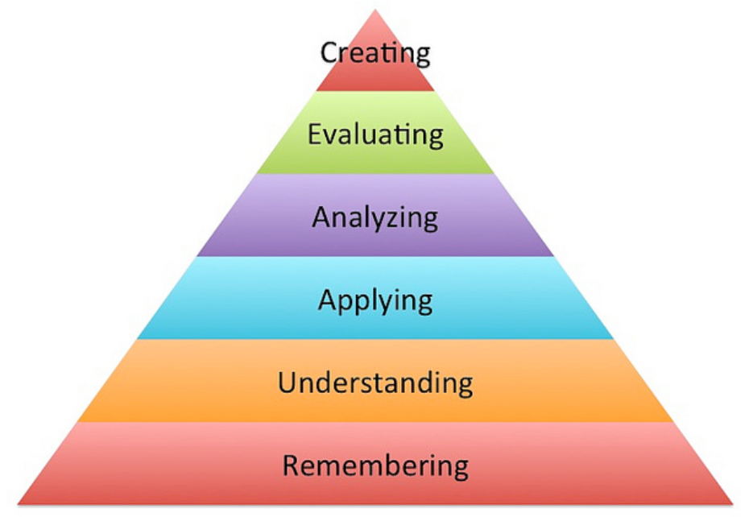
The Cognitive Domain of Learning
The New Version of Bloom’s Taxonomy
Notes:
Taxonomy /tækˈsɑː.nə.mi/: a system for naming and organizing things, especially plants and animals, into groups that share similar qualities BẢNG PHÂN LOẠI

Slide 9
DESCRIPTIONS OF THE BLOOM’S TAXONOMY - THE COGNITIVE DOMAIN
MAIN SKILL LEVELS | DESCRIPTION
Remembering | When you are skilled in remembering, you can recognize or recall knowledge you’ve already gained, and you can use it to produce or retrieve or recite definitions, facts, and lists.
Understanding | Understanding is the ability to grasp or construct meaning from oral, written, and graphic messages.
Applying | When you apply, you use learned material (or you implement the material) in new and concrete situations.

Slide 10
DESCRIPTIONS OF THE BLOOM’S TAXONOMY - THE COGNITIVE DOMAIN
MAIN SKILL LEVELS | DESCRIPTION
Analyzing | When you analyze, you have the ability to break down or distinguish the parts of material into its components, so that its organizational structure may be better understood.
Evaluating | With skills in evaluating, you are able to judge, check, and even critique the value of material for a given purpose.
Creating | With skills in creating, you are able to put parts together to form a coherent or unique new whole. You can reorganize elements into a new pattern or structure through generating, planning, or producing.

Slide 11

2. Creative Thinking Skills
“Everybody has a creative potential and from the moment you can express this creative potential, you can start changing the world.”
Paulo Coelho, author and lyricist

Slide 12

Creative Thinking
Everyone has creative abilities. It’s true of everyone who fully expresses creative abilities as well as those who express them very little or not at all.
All humans are innately creative, especially if creativity is understood as a problem-solving skill.
Creativity is inspired when there is a problem to solve. As a creative thinker, you are curious, optimistic, and imaginative.
Creativity is inspired when there is a problem to solve. Considered as an act of problem-solving, creativity can be understood as a skill—as opposed to an inborn talent or natural “gift”—that can be taught as well as learned.
Notes:
Innate /ɪˈneɪt/: An innate quality or ability is one that you were born with, not one you have learned

Slide 13
ACTIVITY: ASSESS YOUR CREATIVE PROBLEM-SOLVING SKILLS
Objective
Evaluate your attitude toward problem-solving in the context of cultivating creative thinking.
Directions:
Access Psychology Today’s Creative Problem-Solving Test at the Psychology Today Web site.
Read the introductory text, which explains how creativity is linked to fundamental qualities of thinking, such as flexibility and tolerance of ambiguity.
Then advance to the questions by clicking on the “Take The Test” button. The test has 20 questions and will take roughly 10 minutes.
After finishing the test, you will receive a Snapshot Report with an introduction, a graph, and a personalized interpretation for one of your test scores.
Complete any further steps by following your instructor’s directions.

Slide 14

Creative Thinking in Education
Design sample exam questions to test your knowledge as you study for a final.
Devise a social media strategy for a club on campus.
Propose an education plan for a major you are designing for yourself.
Prepare a speech that you will give in a debate in your course.
Develop a pattern for a costume in a theatrical production.
Arrange audience seats in your classroom to maximize attention during your presentation.
Arrange an eye-catching holiday display in your dormitory or apartment building.
College is great ground for enhancing creative thinking skills.
These are some college activities that can stimulate creative thinking. Are any familiar to you?

Slide 15
Creative Thinking in Education
Participate in a brainstorming session with your fellow musicians on how you will collaborate to write a musical composition.
Draft a script for a video production that will be shown to several college administrators.
Compose a set of requests and recommendations for a campus office to improve its customer service.
Develop a marketing pitch for a mock business you are developing.
Develop a comprehensive energy-reduction plan for your cohousing arrangement.
College is great ground for enhancing creative thinking skills.
These are some college activities that can stimulate creative thinking. Are any familiar to you?

Slide 16

How to Stimulate Creative Thinking
Sleep on it. Over the years, researchers have found that the REM sleep cycle boosts our creativity and problem-solving abilities, providing us with innovative ideas or answers to vexing dilemmas when we awaken. Keep a pen and paper by the bed so you can write down your nocturnal insights if they wake you up.
Go for a run or hit the gym. Studies indicate that exercise stimulates creative thinking, and the brainpower boost lasts for a few hours.
Allow your mind to wander a few times every day. Far from being a waste of time, daydreaming has been found to be an essential part of generating new ideas. If you’re stuck on a problem or creatively blocked, think about something else for a while.

Slide 17
How to Stimulate Creative Thinking
Keep learning. Studying something far removed from your area of expertise is especially effective in helping you think in new ways.
Put yourself in nerve-racking situations once in a while to fire up your brain. Fear and frustration can trigger innovative thinking.
Keep a notebook with you so you always have a way to record fleeting thoughts. They’re sometimes the best ideas of all.

Slide 18
A Brainstorm of Tips for Creative Thinking
The best way to have a good idea is to have lots of ideas.
—Linus Pauling, double Nobel Laureate, chemist, biochemist, and peace campaigner

Slide 19
A Brainstorm of Tips for Creative Thinking
SENSING
Use all your senses - see, taste, smell, touch, hear, think, speak.
Be a good observer of people, nature, and events around you.
THINKING
Engage thinking on the right side of your brain (intuition, open-mindedness, visual perception, rhythm . . .).
Change your interpretation of an event, situation, behavior, person, or object.
Allow ideas to incubate.
Be open to insight as ideas pop into your mind.

Slide 20
A Brainstorm of Tips for Creative Thinking
IMAGINING
Brainstorm by generating ideas with a group of people.
Ask, “What would happen if . . .”
Ask, “In how many different ways . . .”
Develop ideas and expand their possibilities.
Envision the future.

Slide 21
A Brainstorm of Tips for Creative Thinking
SPEAKING AND WRITING
Use your words and your “voice” when conveying your original ideas.
Avoid using clichés or overly familiar responses to questions or problems.
Explain how your ideas move beyond the status quo and contribute to a discussion.
Take notes.

Slide 22
A Brainstorm of Tips for Creative Thinking
DRAWING
Use mind-mapping to capture ideas; start with a key concept and write it in the center of your page; use connecting lines, radiating from the central concept, and write down any connected or related ideas that come to you.
Create pictures or drawings of situations (“rich pictures”) to show them in a different way.

Slide 23
A Brainstorm of Tips for Creative Thinking
LEARNING
Find ways to demonstrate your personal investment in projects.
Gather knowledge and conduct research.
Have more fun learning!
MOVING
Do physical activities to engage the creative areas of your brain and think differently.
RESTING
Take breaks.

Slide 24

Creative Thinking Fiction and Facts

Slide 25

Creative Thinking - Fiction and Facts
FICTION
FACTS
Every problem has only one solution (or one right answer).
Most problems can be solved in any number of ways.
If you discover a solution that works, it’s a good solution.
Other people may think up solutions that differ from yours, but that doesn’t make your solution wrong or unimportant.

Slide 26
Creative Thinking - Fiction and Facts
FICTION
FACTS
Look at the history of any solution and you’ll see that improvements, new solutions, and new right answers are always being found.
The ox or horse, the cart, the wagon, the train, the car, the airplane, the jet, the space shuttle? What is the best and last?
The best answer or solution or method has already been discovered.

Slide 27
Creative Thinking - Fiction and Facts
FICTION
FACTS
Only a few problems require complex technological solutions.
Most problems you’ll encounter need only a thoughtful solution involving personal action and perhaps a few simple tools.
Even many problems that seem to require technology can be addressed in other ways.
Creative answers are technologically complex.

Slide 28
Creative Thinking - Fiction and Facts
FICTION
FACTS
There are many successful techniques for generating ideas. One important technique is to include structure.
Create guidelines, limiting parameters, and concrete goals for yourself that stimulate and shape your creativity.
Ideas either come or they don’t. Nothing will help - certainly not structure.

Slide 29
THINKING AND ANALYSIS (cont.)

Slide 30
Chapter outlines
THINKING AND ANALYSIS
Creative Thinking Skills (cont.)
Notes:
Pattern /ˈpæt̬.ɚn/:

Slide 31

LEARNING OBJECTIVES
By the end of this section, you will be able to:
Describe the role of creative thinking skills in problem-solving
Identify technology tools that enhance our learning
Explain how technology skills relate to critical/creative thinking skills
Examine online learning in the context of organizing, communicating, reading, and researching online
Assess our readiness to use technology

Slide 32

Creative problem-solving is a type of problem-solving. It involves searching for new and novel solutions to problems.
Unlike critical thinking, which scrutinizes assumptions and uses reasoning, creative thinking is about generating alternative ideas - practices and solutions that are unique and effective.
It’s about facing sometimes muddy and unclear problems and seeing how “things” can be done differently - how new solutions can be imagined.
Problem-Solving with Creative Thinking
Notes:
Scrutinize /ˈskruː.t̬ən.aɪz/: to examine something very carefully in order to discover information

Slide 33
Activity
Brainstorming
Project start up "Social initiative":
Discuss in small groups, propose a creative social initiative, to solve any problem our society.

Slide 34
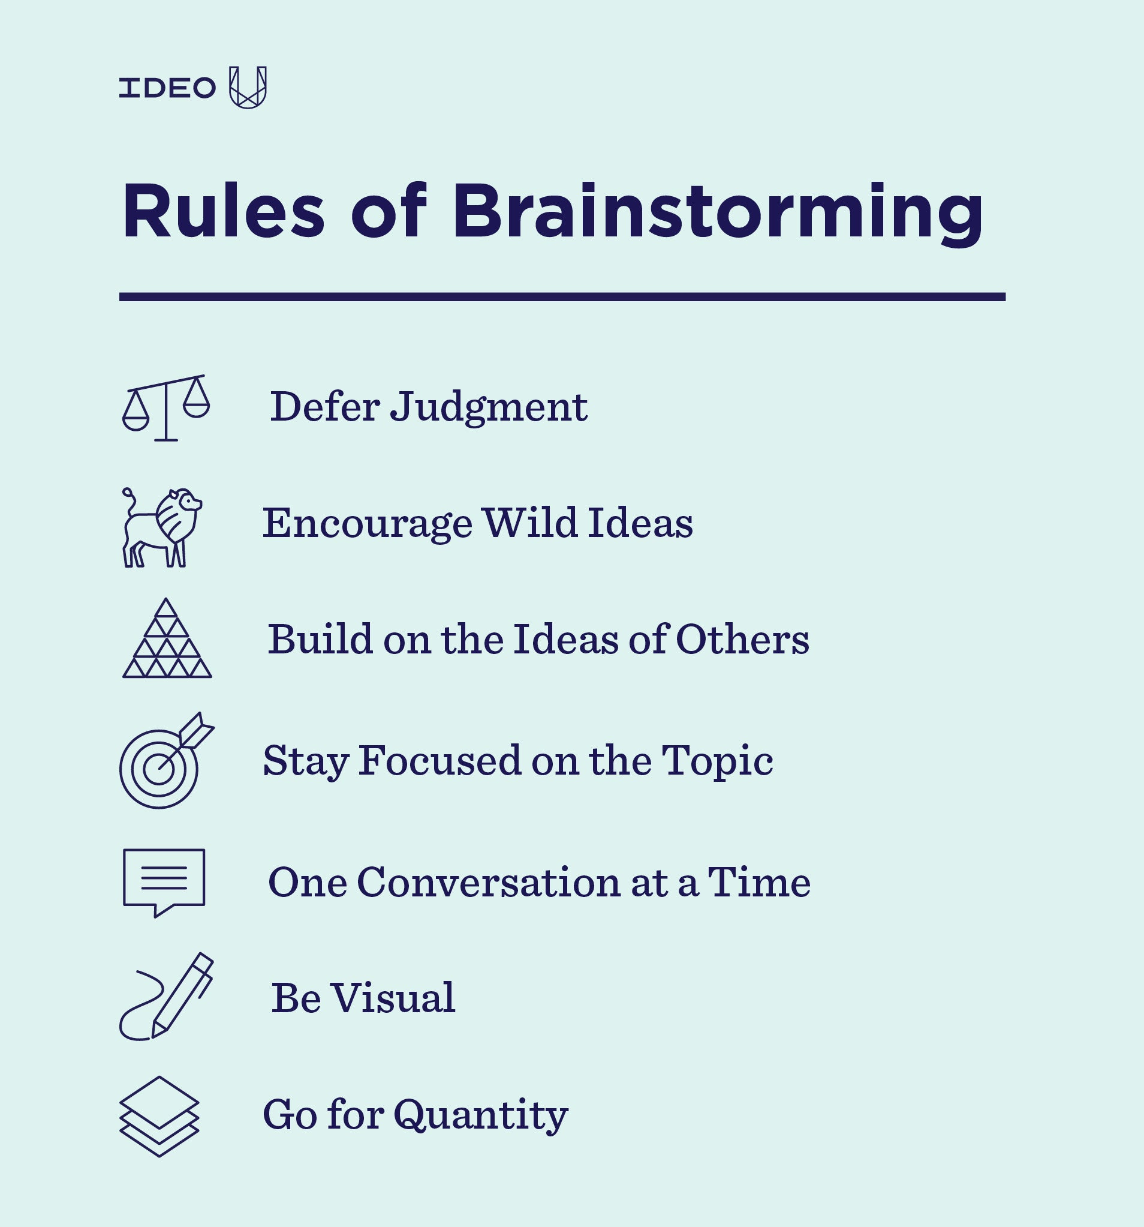
Notes:
Defer = delay / postpone

Slide 35
Brainstorming technique
Start
Ideas generation
Ideas combination
Evaluation & Validation
Generate new ideas
Selection of best ideas
End

Slide 36


